Slide 1


Zeno or ITWiz AI IT Smart Agent Empowering CSS Organization with Intelligent IT Support
April 2024

Slide 2
Table of Contents
Introduction
The Challenge
The Opportunity
Key Features
Business Benefits
Technical Architecture
Implementation Roadmap
Project Team and Resources
Budget and ROI
Conclusion and Call to Action

Slide 3
Introduction
The purpose of this document is to provide a detailed approach for building an AI agent capable of accessing and understanding the extensive knowledge base maintained by SAP Concur.
The AI agent will serve as a centralized hub for answering questions and providing insights related to the company's complex landscape of systems, integrations, initiatives, and design decisions.

Slide 4
The Challenge
Fragmented IT Documentation: Essential IT knowledge scattered across disparate platforms such as SharePoint, Wiki, and Jira, leading to inefficiencies in accessing and utilizing information.
Lengthy Response Times and Expert Dependency: Current processes heavily reliant on experienced staff members for IT insights, resulting in delays and bottlenecks in addressing user queries and issues.
Over-Reliance on Few Subject Matter Experts (SMEs): Critical areas heavily dependent on the expertise of a few individuals, creating vulnerabilities and potential disruptions in the event of their absence or departure.
Risk of Knowledge Loss and Inability to Backfill: Employee turnover poses a significant risk of valuable institutional knowledge loss, compounded by challenges in finding suitable replacements and transferring expertise.
Vendor Dependency and Critical Dependency Risks: Heavy reliance on external vendors for key IT solutions, leading to potential vendor lock-in and critical dependency risks, impacting organizational agility and autonomy. Vendor resources can change and loss of knowledge.
Inefficiencies in Information Retrieval: Substantial effort required to locate answers to IT-related questions, often resulting in incomplete or inaccurate information, impacting decision-making and operational effectiveness

Slide 5
The Opportunity
Centralized Knowledge Hub: Consolidate scattered IT documentation into a single, accessible platform, e.g., Solution Intent
Rapid Response through AI Agent: Reduce dependency on experienced staff by enabling quick access to information and democratizing access to IT knowledge.
Updated Insights: Ensure up-to-date and comprehensive information on IT solutions for informed decision-making.
Knowledge Retention: Mitigate risks of knowledge loss due to employee turnover through centralized knowledge management and reducing reliance on a few key individuals.
Vendor Independence: Enhance organizational autonomy by reducing critical dependency on external vendors.
Streamlined Operations: Improve efficiency through faster and more accurate information retrieval, enhancing overall productivity.
Driving Growth: Fuel organizational growth and agility by leveraging technology to optimize operations and drive strategic initiatives.
Summarize documents/content – provide links to actual docs, create docs
Critical Support strategic initiatives such as NGCS – Offer timely and accurate information, helping to capture accurate business requirements, streamline processes and ensure alignment with business goals.
Global Collaboration: Address time zone challenges by enabling global teams to access information without waiting for SMEs, ensuring continuous support and reducing delays.
Scalable Solution: Extend the IT agent to other lines of business (LOBs), providing a unified support system across the organization and maximizing the return on investment.

Slide 6
Key Features of the IT Agent
Conversational Interface: Intuitive user interaction for seamless communication.
Integration: Seamlessly connects with existing data sources, knowledge base, and IT systems.
Data Security: Robust measures for secure and privacy-preserving data handling.
Continuous Improvement: Iterative enhancements driven by user feedback and machine learning.
Centralized Knowledge Base: Consolidation of IT documentation, information, and integration details for centralized access.
Natural Language Processing: Capabilities to comprehend and respond to user queries.
Intelligent Response Generation: Generation of contextually relevant responses and efficient information retrieval.
Contextual Understanding: Ability to understand user context and provide personalized assistance.
Scalability: Cloud-based architecture ensuring high availability and scalability.
Continuous Learning: Ongoing learning and updates to the knowledge base for relevance and accuracy.
Multi-Channel Support: Offers support across various channels such as web, mobile, and voice interfaces.
Analytics and Insights: Provides analytics and insights on user interactions and knowledge usage for optimization.
These features collectively empower the IT agent to deliver efficient and effective support, ensuring optimal utilization of organizational resources and enhancing user experience.

Slide 7
Business Benefits
Tangible benefits the IT Agent will bring to the organization:
Reduced IT support workload and improved response times
Consistent and accurate information delivery to end-users
Preservation of institutional knowledge and reduced risk of knowledge loss
Increased productivity and efficiency across the organization
Enhanced user satisfaction and improved IT service quality
Cost savings from reduced reliance on experienced IT staff
Aligns with the organization's strategic goals and priorities around AI adoption and location strategy

Slide 8
Security and Privacy
Security and privacy are of utmost importance for this project. The following measures will be implemented:
Access to sensitive data and system information will be restricted, and the AI agent will not store or use this data outside the company's infrastructure.
Compliance with regulations such as GDPR and government data handling standards will be ensured.
User authentication and authorization mechanisms will be implemented to control access to the AI agent.
Regular security audits and penetration testing will be conducted to identify and mitigate potential vulnerabilities.
PET and Security Concept? Exclude PII?

Slide 9
Data Preparation
Data Collection: Gather relevant documentation on IT applications in various formats.
Data Cleaning: Remove irrelevant information and standardize formatting.
Data Annotation: Add metadata and annotate key entities and concepts.
Data Structuring: Organize documentation into a structured format for easy navigation.
Data Enrichment: Enhance documentation with additional metadata and links.
Data Indexing: Index structured data for efficient retrieval using search engines.
Data Validation: Ensure quality and accuracy through testing and verification.
Data Versioning: Implement version control to track changes over time.
Data Access Control: Restrict access to sensitive information using access control measures.
Data Governance: Establish policies for managing and maintaining documentation.
Exclude PII

Slide 10
Architecture
RAG – Retrieval Augmented Generation
Open AI GPT via AI Core – part of CPIT AI factory

Slide 11





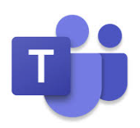
RAG Architecture Retrieval Augmented Generation
Response based on Company Knowledge Base
Chat/User Interface
Prompt augmented with Context
Large Language Model (LLM)
User Query / Prompt
Updated Prompt
Retrieval Results
Phase 1
Phase 2
Vector Database
Embedding Model
Document Ingestion, Vectorization

Slide 12
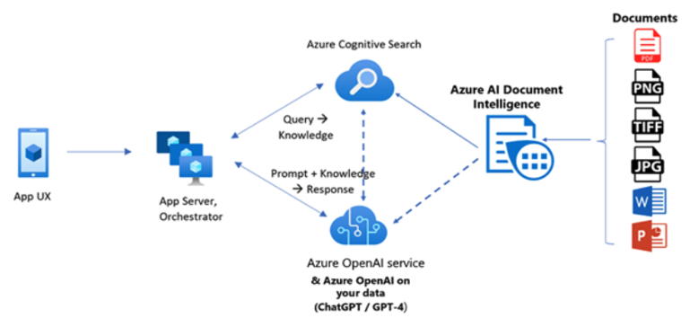
Architecture - Azure
SAP BTP

Slide 13
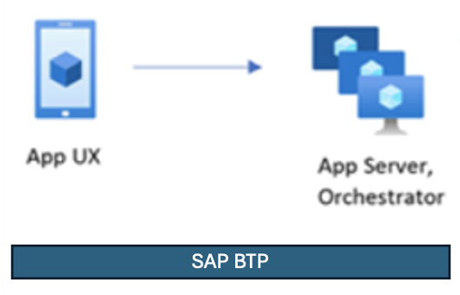
Architecture - SAP
Training and Search
Phase 1 – Documents, Images, databases
Phase 2 – videos, Teams recordings, etc.
Data Ingestion
SAP AI Model and search

Slide 14
Architecture – SAP Technology
WIP / Paula
Extended Enterprise Content Mgmt. (ECM)
Phase 1 – Documents, Images, databases
Phase 2 – videos, Teams recordings, etc.
Document Information Extraction
Supported Doc types
Unsupported doc types via Generative IA
SAP Application Studio
SAP Business Technology Platform (BTP)

Slide 15
Solutions and Services
Capability | Tool
Document Repository | SharePoint, Wiki,
Embedding Model, Document ingestion | Cognitive Search using Azure AI document intelligence
Vectorization - Information extraction - that will extract all the information from documents (PDFs) | data preparation script using Azure AI Document Intelligence Layout service.
Run supported chat models such as GPT-35-Turbo and GPT-4 on your data without needing to train or fine-tune models | Azure OpenAI on your data

Slide 16
Typical Roles in Gen-AI project
Senior Management Sponsor:
Provides strategic direction and resources
Cloud Engineer:
Ensures infrastructure is robust, secure, and scalable
Software Developer:
Integrates gen-AI into existing systems and applications
Project Manager:
Εnsures milestones are met on budget
QA Engineer:
Tests gen-AI systems to meet company standards
Business Analyst and Domain Experts:
Tailor gen-AI solution to solve real world business problems
Cybersecurity and Data Security Experts:
Εnsure data is encrypted, compliant, and safe
Evaluate ethical implications and potential risks
Data Scientists and Machine Learning Engineers
Train Gen-AI models

Slide 17
Implementation Roadmap
 | APR |  | MAY |  | JUN |  | JUL |  |  | AUG |  | SEP |  | OCT |  | NOV |  | DEC
 | 10 | 24 | 8 | 22 | 5 | 19 | 3 | 17 | 31 | 14 | 28 | 11 | 25 | 9 | 23 | 6 | 20 | 4 | 18
Approach
Approach and Design
Team Setup
Design
Proof of Concept
MVP
MVP Build
Document Repository
Early Adopters
Phase 2 Build Out
Phase 2
Testing
GA within CSS
Bug fixes
Deploy
Testing

Slide 18
Project Team and Resources
Preetish Prakash
Devarshi Dwivedy
Modern Times Team (Mohan, Saurabh and Ananda)
Yamini Kothari
Paula Hurtado
Amit Sharma
Terah Gumm
Arya Singh
Brandon Matson
Jeffrey Truong
Minal Chopade

Slide 19
Budget and ROI
Open: Potential costs and funding asks.

Slide 20
Next steps
Evaluate and select the appropriate NLP libraries, language models, and cloud platforms based on the requirements and constraints.
Develop a proof-of-concept or minimum viable product (MVP) to validate the approach and gather feedback from users.
Iterate and refine the design based on feedback and lessons learned from the MVP.
Develop a comprehensive project plan, including timelines, resource allocation, and risk mitigation strategies.
Implement the AI agent following best practices for software development, testing, and deployment.
Conduct user acceptance testing and gather feedback for continuous improvement.
Develop a change management plan and training materials for end-users and IT support staff.
Establish a governance framework for ongoing maintenance, updates, and enhancements of the AI agent.

Slide 21
TBD

Slide 22
TBD

Slide 23
TBD

Slide 24
TBD

Slide 25

Preetish Prakash preetish.prakash@sap.com

Slide 28

APPENDIX

Slide 29
Google - SAP
Google Vector Search
Phase 1 – Documents, Images, databases
Phase 2 – videos, Teams recordings, etc.
Data Ingestion
Google cloud?
Gemini AI Model

Slide 30
Architecture
Phase 1 – Documents, Images, databases
Phase 2 – videos, Teams recordings, etc.
Chat Interface
AI Model and search
Training
Data Ingestion

Slide 31
RAG Architecture
Chat/User Interface
Prompt augmented with Context
Large Language Model (LLM)
User Query
Retrieval Results
Phase 2 – videos, Teams recordings, etc.
Phase 1 – Documents, Images, databases
Phase 1
Phase 2
Vector Database
Document Ingestion, Vectorization

Slide 32
RAG Architecture
Phase 1 – Documents, Images, databases
Phase 2 – videos, Teams recordings, etc.
AI Model and search
Training
Data Ingestion
Chat Interface
Prompt augmented with Context

Slide 33
TBD

Slide 34
APPENDIX

